Slide 1
Developing Trust in Artificial Intelligence and Machine Learning for High-Stakes Applications Kush R. Varshney krvarshn@us.ibm.com @krvarshney

Slide 2
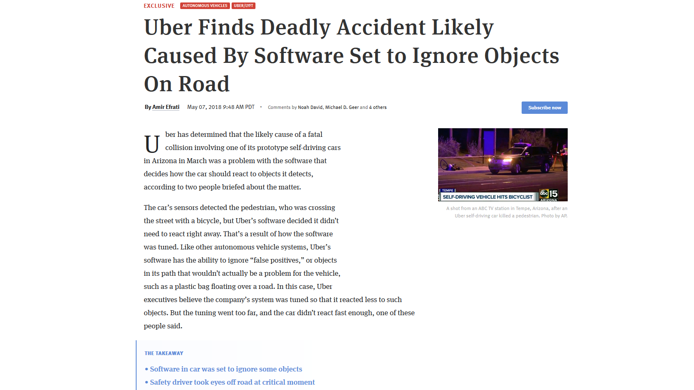
Pneumonia patients with a history of asthma predicted to have lower mortality risk than general population

Slide 3
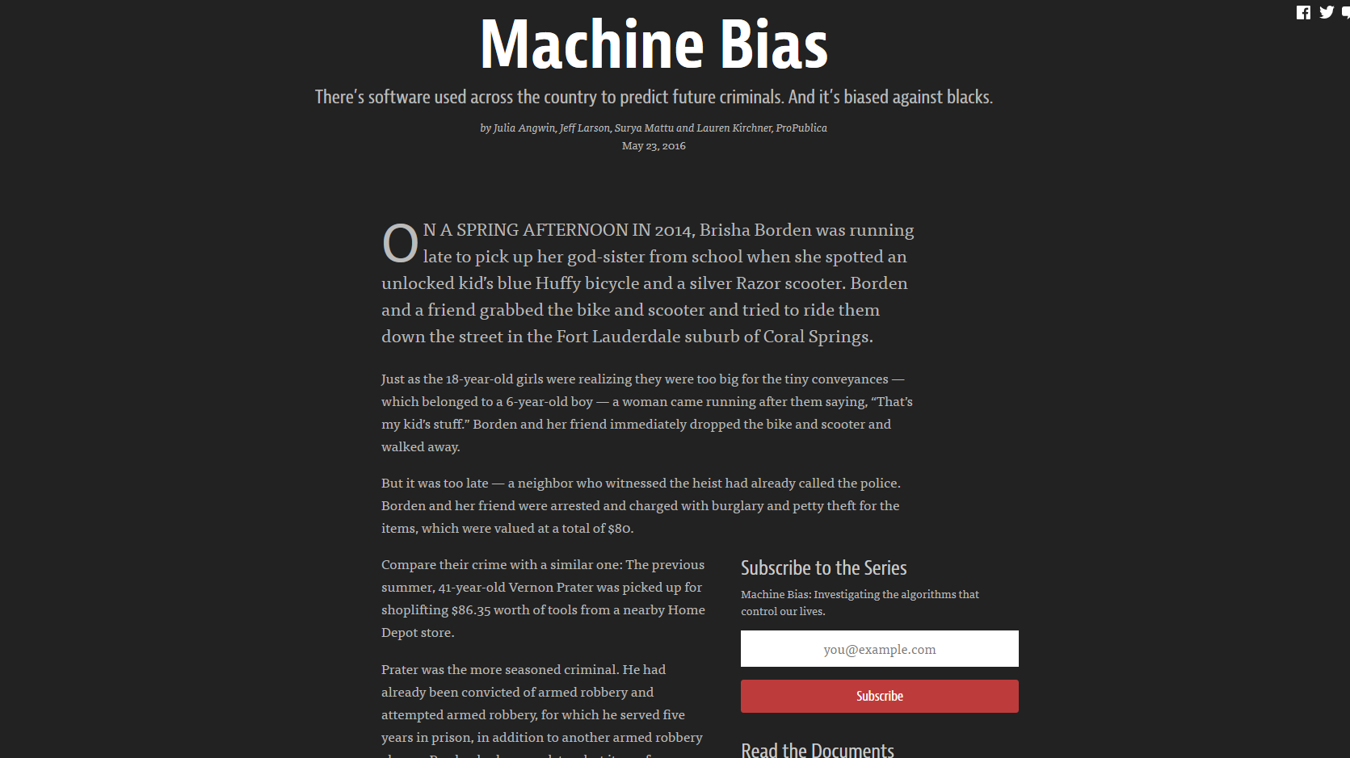

Slide 4
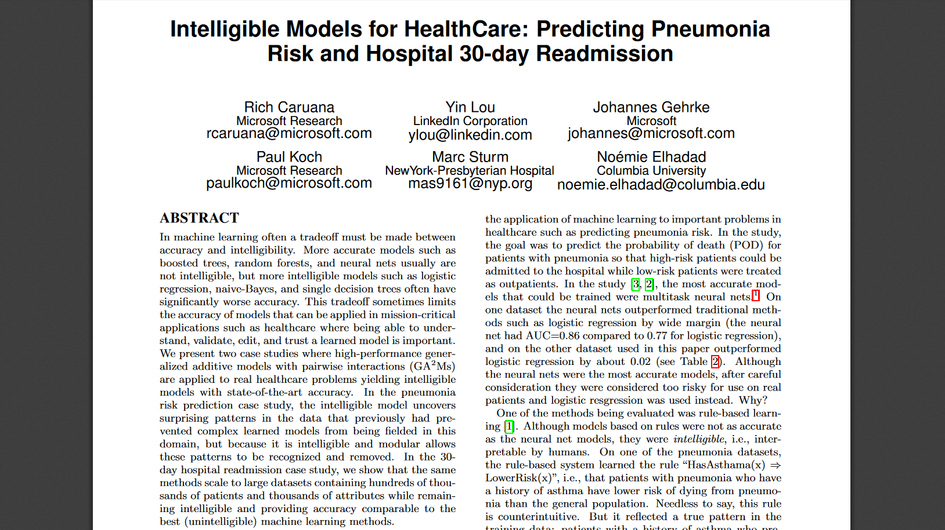

Slide 5
Topics
Trustworthy machine learning and artificial intelligence
Epistemic uncertainty and safety
Fairness
Understanding Unequal Performance of Gender Classification from Face Images
Optimized Pre-Processing
Fairness GAN
AI Fairness 360 Toolkit
Conclusion

Slide 6
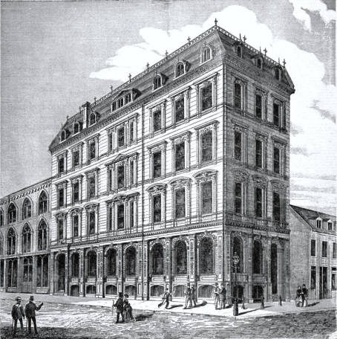
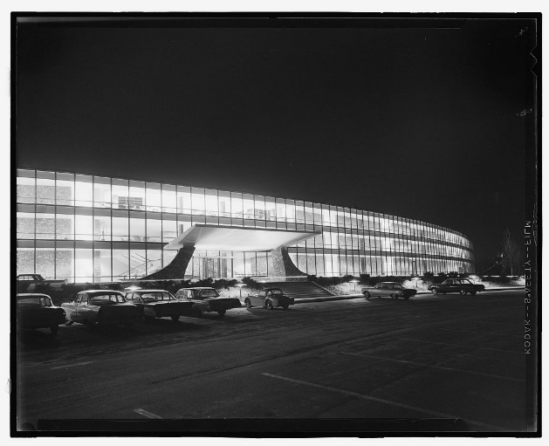
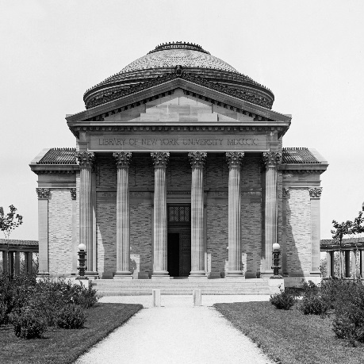
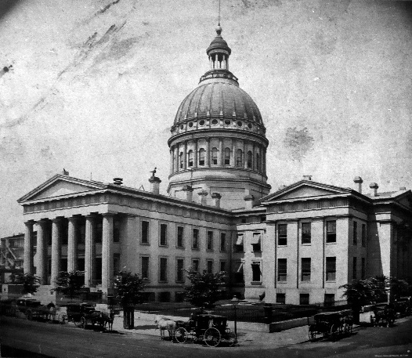
AI is now used in many high-stakes decision making applications
Credit
Employment
Education
Criminal Justice

Slide 7
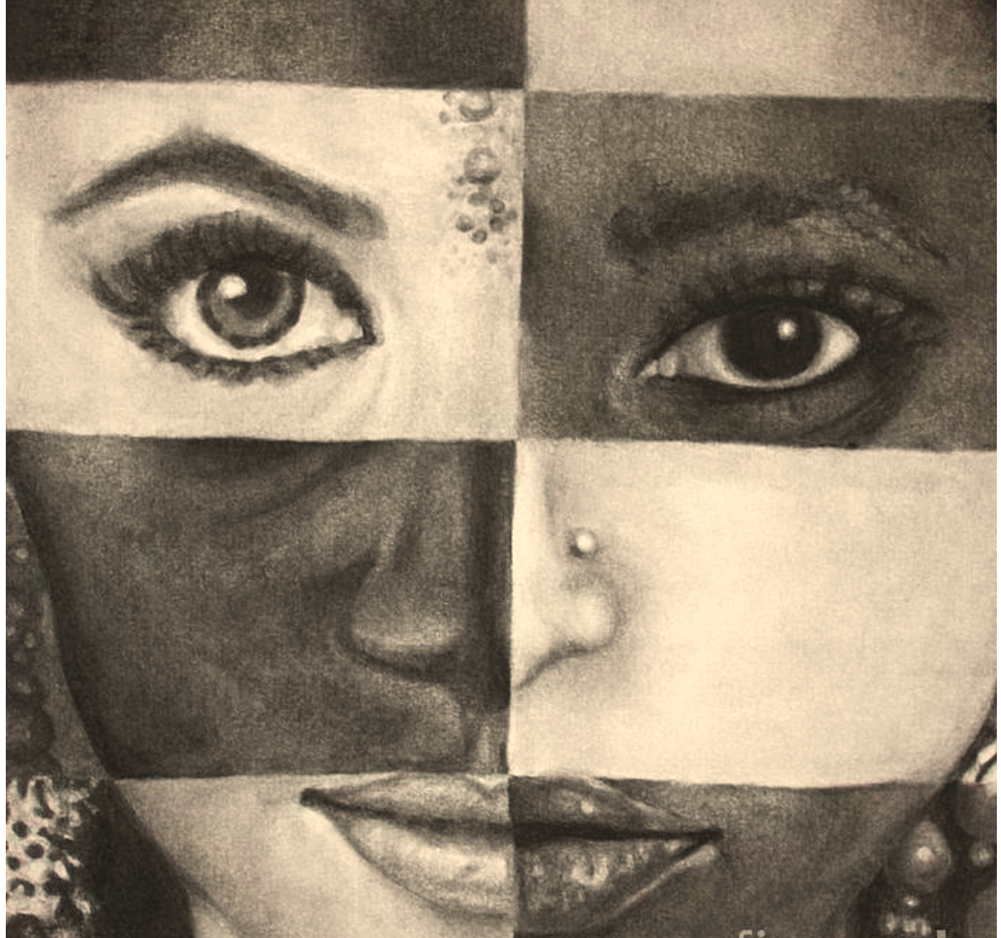
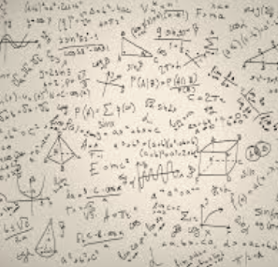
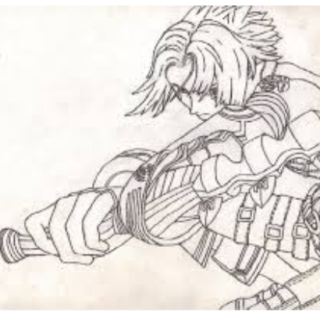
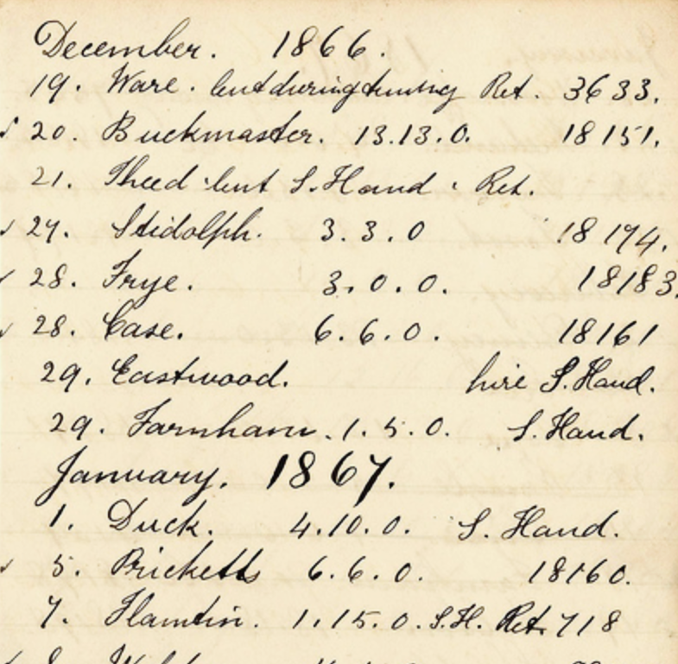
What does it take to trust a decision made by a machine? (Besides it being 99% accurate)
Is it fair?
Is it easy to understand?
Did anyone tamper with it?
Is it accountable?

Slide 8
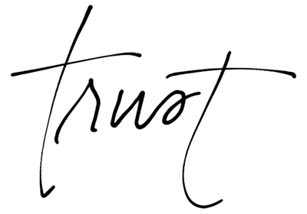
Trust

Slide 9
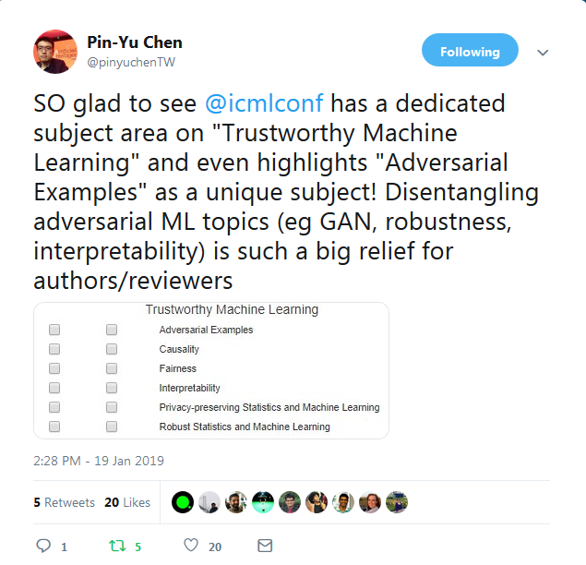
ICML’s Definition

Slide 10
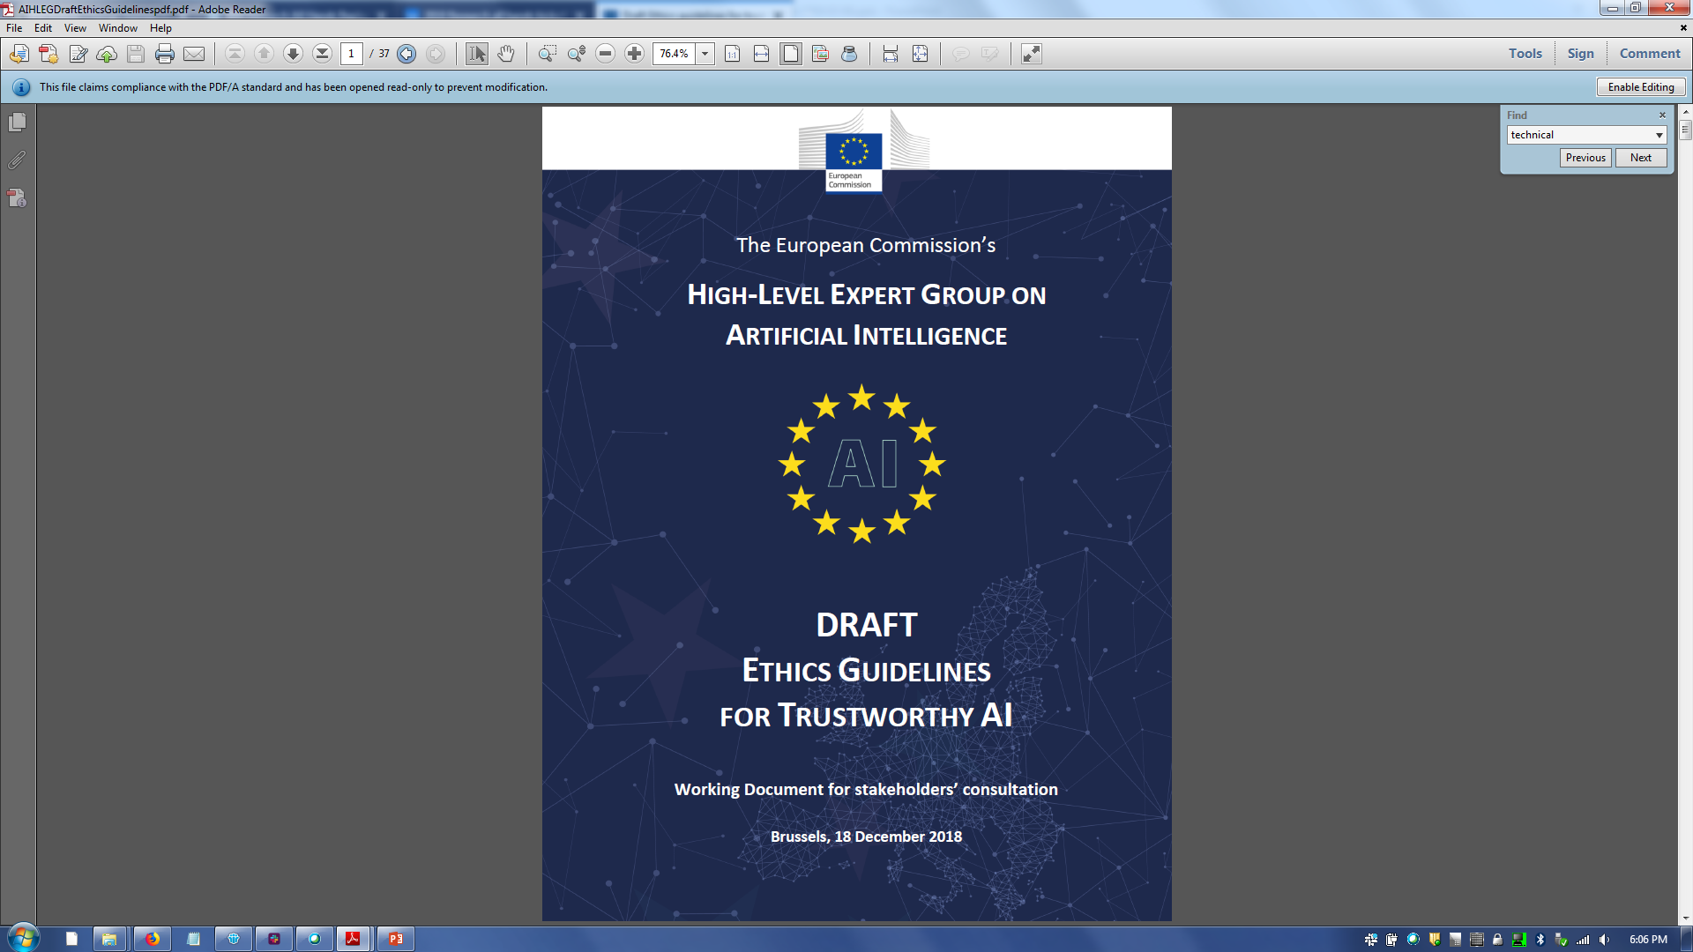
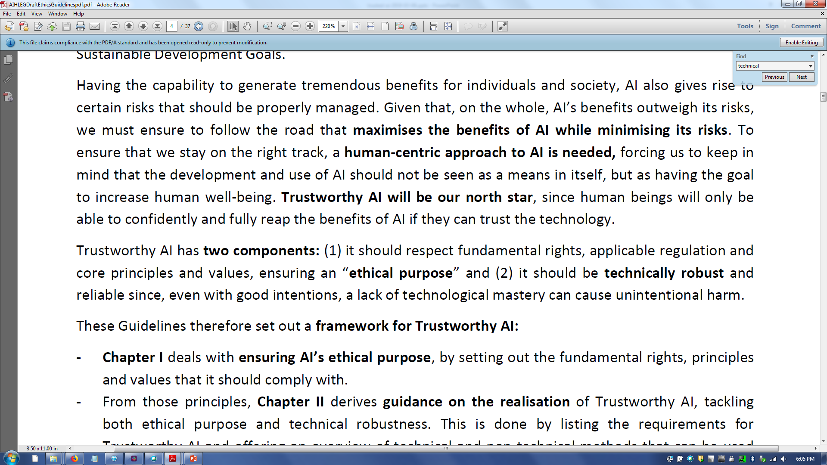
European Commission’s Definition

Slide 11
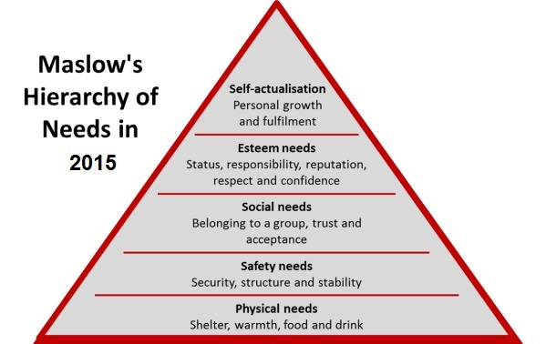
Maslow’s Hierarchy of Needs

Slide 12
Hierarchy of Needs for AI
transparency
safety and security
basic accuracy

Slide 13
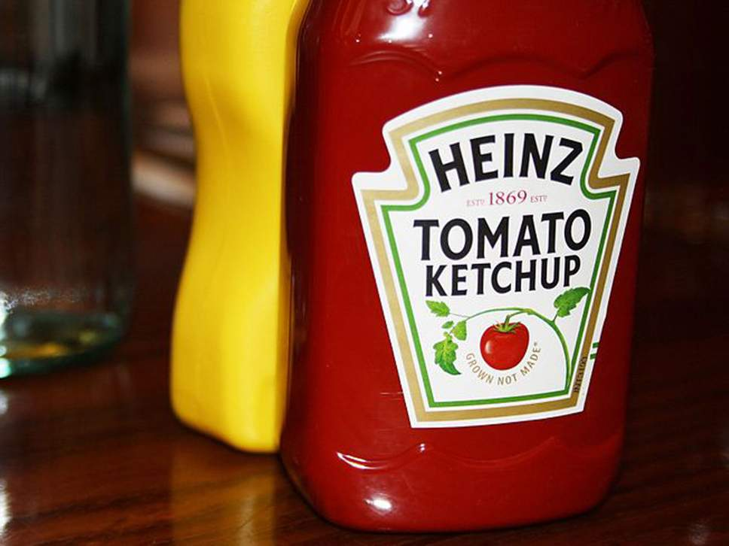
K. R. Varshney, “Trustworthy Machine Learning and Artificial Intelligence,” ACM XRDS Magazine, Spring 2019.

Slide 14
Analogy with Processed Food
Unadulterated ingredients
Transparent containers
Innovative sanitary food preparation
Factory tours
Pure Food and Drug Act
Labels
Tamper-resistant packaging
Blockchain

Slide 15

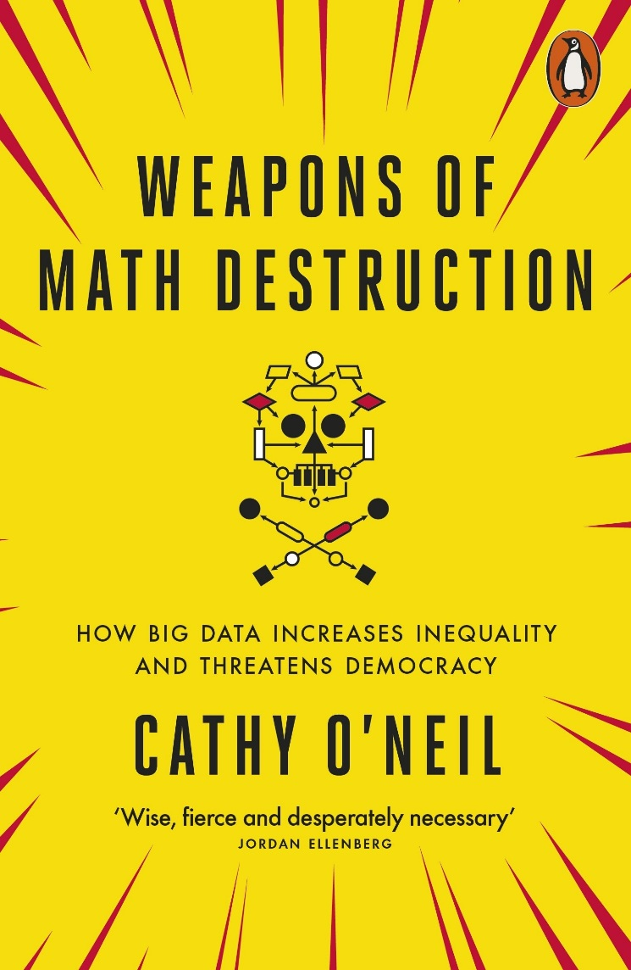
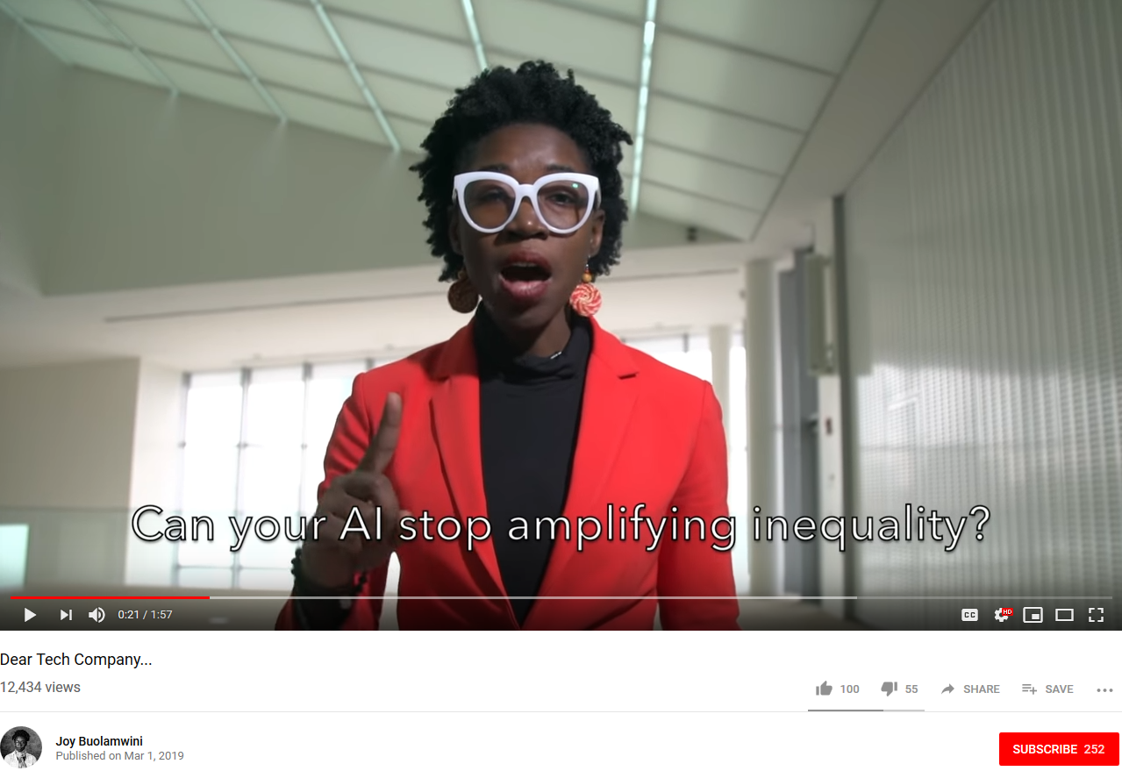
Analogy with Processed Food

Slide 16
Trustworthy Machine Learning and AI
Data quality
Value alignment
Distribution shift
Poisoning and adversarial samples
Fairness
Interpretability
FactSheets
Blockchain
Regulatory affairs

Slide 17
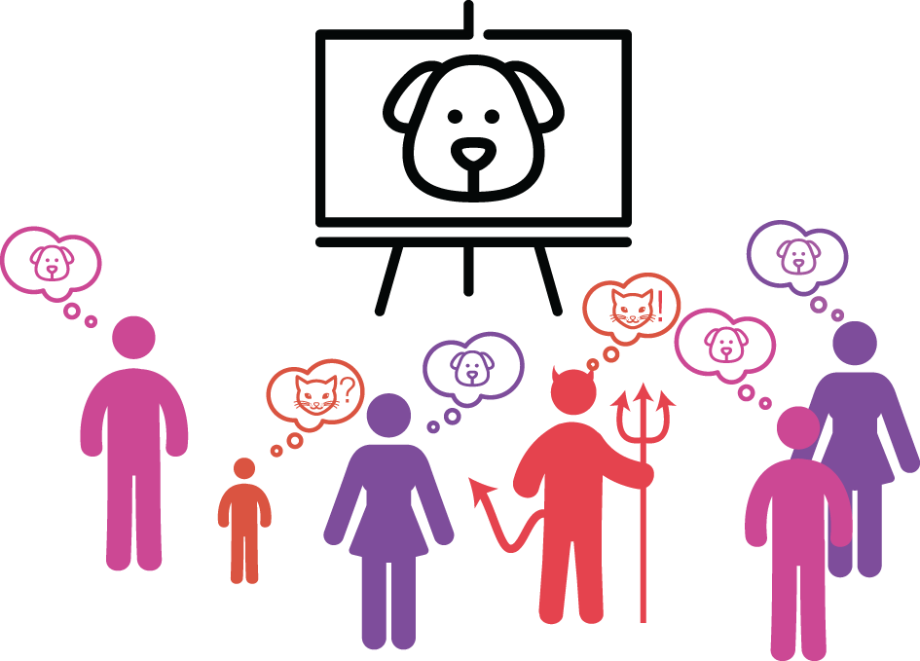
Data Quality

Slide 18
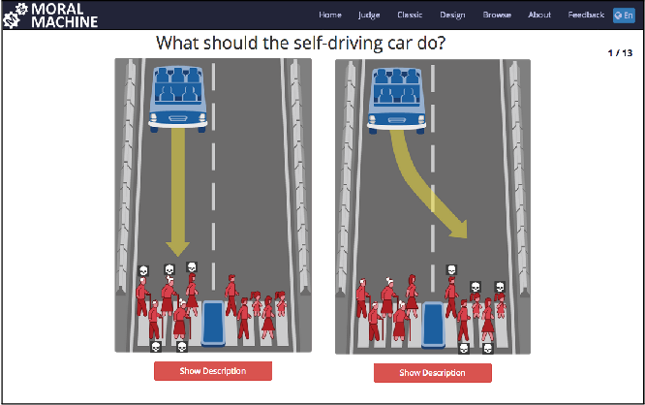
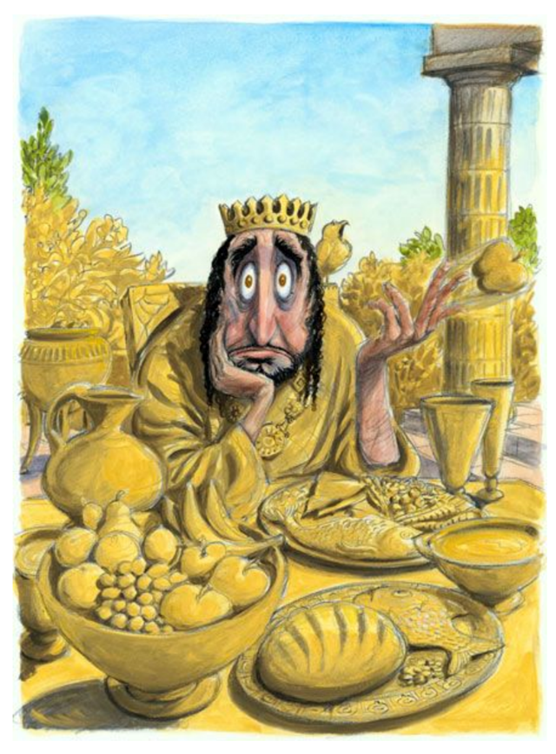
Value Alignment

Slide 19
Distribution Shift
Covariate shift | Distribution of features is different
Prior probability shift | Distribution of labels is different
Concept drift | Distribution of labels given features is different
Confounding shift | Distribution of labels given a variable that influences both features and labels is different

Slide 20
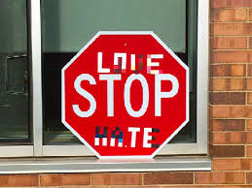
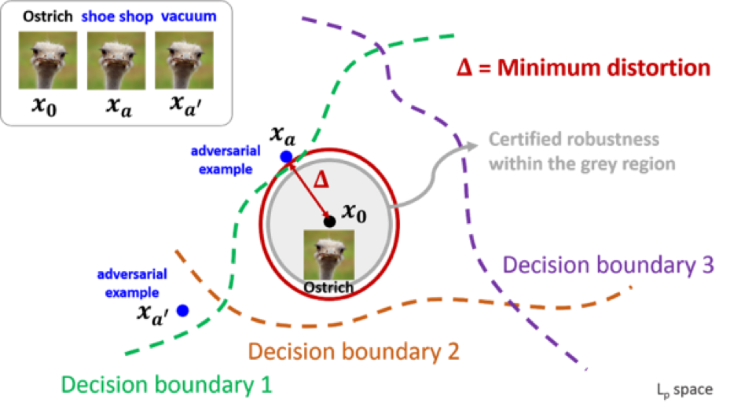
Poisoning and Adversarial Samples

Slide 21
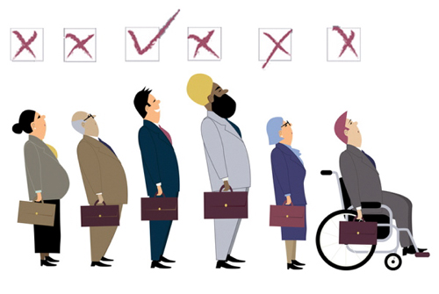
Fairness
Discrimination becomes objectionable when it places certain privileged groups at systematic advantage and certain unprivileged groups at systematic disadvantage.
Unwanted bias in training data yields unwanted bias in models
– Prejudice in labels
– Under- or over-sampling

Slide 22
Interpretability One explanation does not fit all: There are many ways to explain things
directly interpretable vs. post hoc interpretation
global (model-level) vs. local (instance-level)
static vs. interactive (visual analytics, conversation)
The oldest AI formats, such as decision rule sets, decision trees, and decision tables are simple enough for people to understand. Supervised learning of these models is directly interpretable.
Start with a black box model and probe into it with a companion model to create interpretations. The black box model continues to provide the actual prediction while interpretation improve human interactions.
Show the entire predictive model to the user to help them understand it (e.g. a small decision tree, whether obtained directly or in a post hoc manner).
Only show the explanations associated with individual predictions (i.e. what was it about the features of this particular person that made her loan denied).
The interpretation is simply presented to the user.
The user can interact with interpretation.

Slide 23
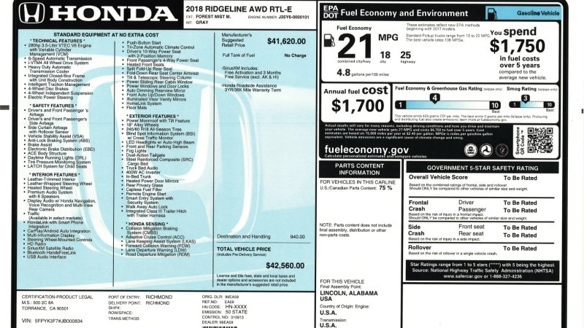
FactSheets

Slide 24
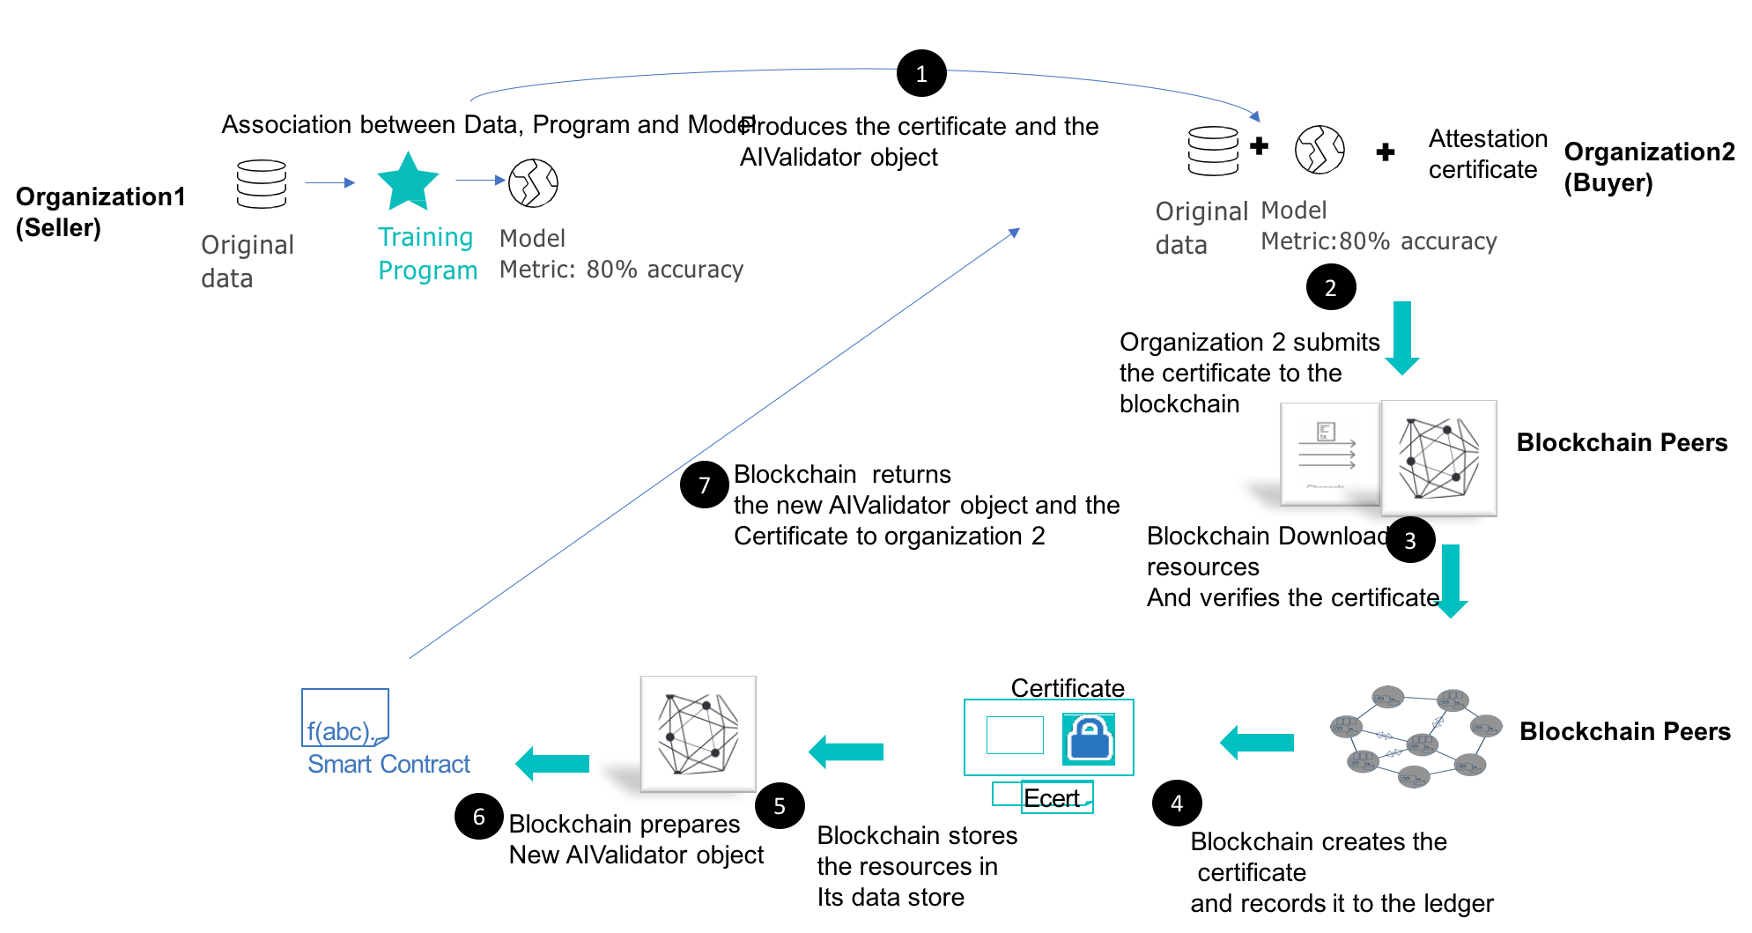
Blockchain

Slide 25
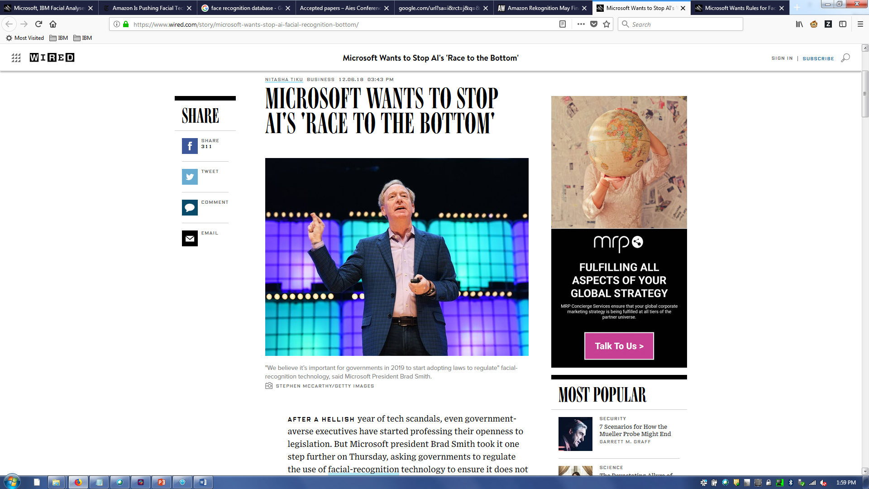
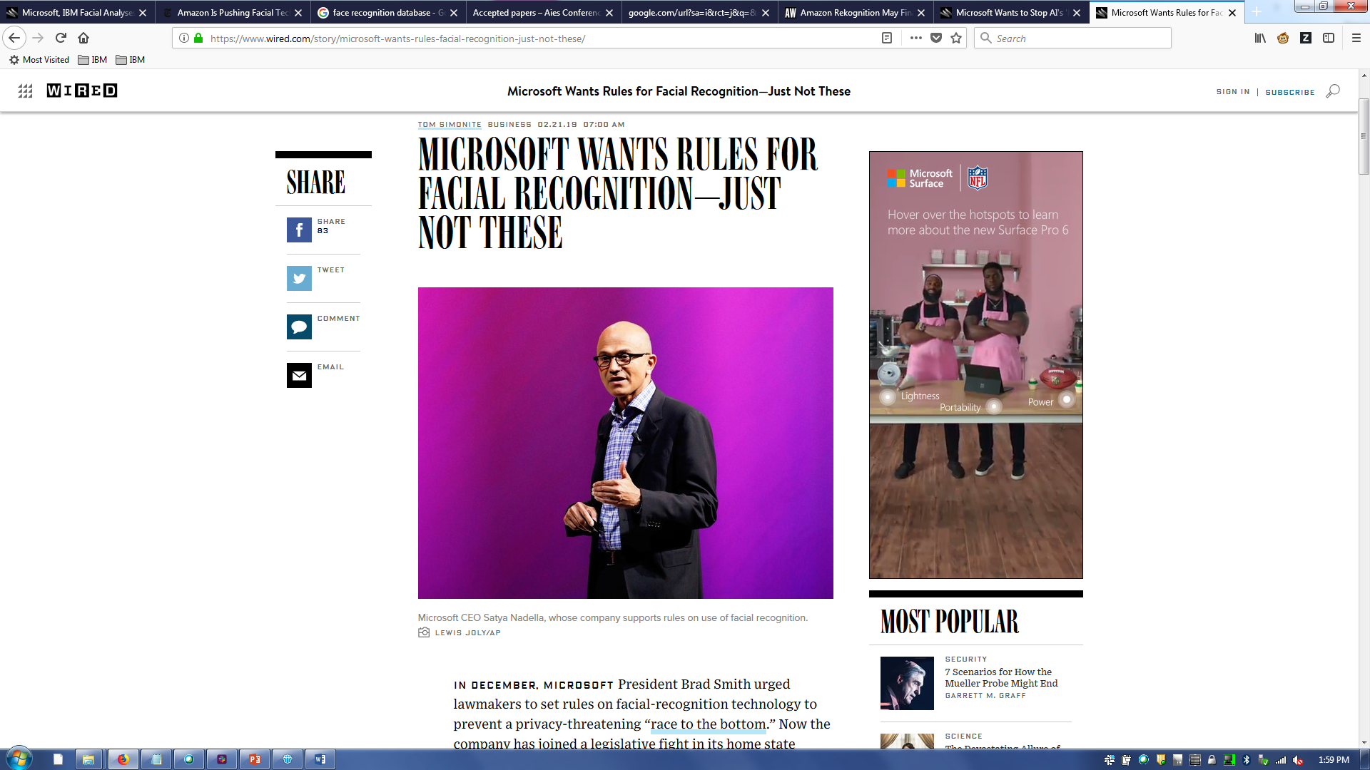
Regulatory Affairs

Slide 26
Topics
Trustworthy machine learning and artificial intelligence
Epistemic uncertainty and safety
Fairness
Understanding Unequal Performance of Gender Classification from Face Images
Optimized Pre-Processing
Fairness GAN
AI Fairness 360 Toolkit
Conclusion

Slide 27

K. R. Varshney and H. Alemzadeh, “On the Safety of Machine Learning: Cyber-Physical Systems, Decision Sciences, and Data Products,” Big Data, vol. 5, no. 3, p. 246–255, Sept. 2017.

Slide 28
Safety
Commonly used term across engineering disciplines connoting the absence of failures or conditions that render a system dangerous (Ferrell, 2010)
Safe food and water, safe vehicles and roads, safe medical treatments, safe toys, safe neighborhoods, safe industrial plants, …
Each domain has specific design principles and regulations applicable only to it
Few works attempt a precise definition applicable broadly
Definition based on harm, risk, and epistemic uncertainty (Möller, 2012)

Slide 29
Harm
A system yields an outcome based on its state and the inputs it receives
The outcome event may be desired or undesired
Outcomes have associated costs that can be measured and quantified by society
An undesired outcome is a harm if its cost exceeds some threshold
Unwanted events of small severity are not counted as safety issues

Slide 30
Risk
We do not know what the outcome will be, but its distribution is known and we can calculate the expectation of its cost
Risk is the expected value of the cost of harm

Slide 31
Epistemic Uncertainty
We still do not know what the outcome will be, but in contrast to risk, its probability distribution is also unknown
Epistemic uncertainty, in contrast to aleatoric uncertainty, results from lack of knowledge that could be obtained in principle, but may be practically intractable to gather

Slide 32
Safety
Safety is the reduction or minimization of risk and epistemic uncertainty of harmful events
Costs have to be sufficiently high in some human sense for events to be harmful
Safety involves reducing both the probability of expected harms and the possibility of unexpected harms

Slide 33

Risk Minimization in Statistical Machine Learning
Risk minimization is the basis of statistical machine learning theory and practice
Features $X∈\text{𝒳}$ and labels $Y∈\text{𝒴}$ with probability density $f_{X,Y}(x,y)$
Function mapping $h∈\text{ℋ}:\text{𝒳}\text{→}\text{𝒴}$
Loss function $L:\text{𝒴}×\text{𝒴}\text{→}\text{ℝ}$
Find $h$ to minimize risk $R\left(h\right)=\text{𝔼}\left[L\left(h(X),Y\right)\right]=\int_{\text{𝒳}}{\int_{\text{𝒴} }{L\left(h\left(x\right),y\right)f_{X,Y}\left(x,y\right)dydx }}$
Given $m$ i.i.d. training samples, not $f_{X,Y}(x,y)$
Empirical risk minimization $R_{m}^{emp}\left(h\right)=\frac{1}{m}\sum_{i=1}^{m}{L\left(h\left(x_{i}\right),y_{i}\right)}$
$R_{m}^{emp}$converges to $R$ uniformly for all $h$ as $m$ goes to infinity (Glivenko-Cantelli)
When $m$ is small, minimizing $R_{m}^{emp}$may not yield an $h$ with small $R$
Restrict complexity of $\text{ℋ}$ based on some inductive bias (Vapnik, 1992)

Slide 34

Epistemic Uncertainty in Machine Learning
Risk minimization has many strengths but does not capture uncertainty
Not always the case that training samples are drawn from true or desired probability distribution of $X,Y$
Model mismatch
Captures distribution shift, adversarial robustness, fairness
Even when drawn from true or desired distribution, training samples may be absent from large parts of $\text{𝒳}×\text{𝒴}$ due to small probability density there

Slide 35

Epistemic Uncertainty in Machine Learning
Statistical learning theory analysis utilizes laws of large numbers to study the effect of finite training data and the convergence of $R_{m}^{emp}$to $R$
In considering safety, should also be cognizant that in deployment, a machine learning system only encounters a finite number of test samples
The actual operational risk is an empirical quantity of the test set
This operational risk may be much larger than the true risk for small cardinality test sets, even if $h$ is risk-optimal
This uncertainty caused by the instantiation of the test set can have large safety implications on individual test samples

Slide 36

Loss Functions in Machine Learning
In risk minimization, the domain of the loss function is $\text{𝒴}×\text{𝒴}$ and the range is an abstract quantity representing prediction error
In real-world applications, the value of the loss function may be endowed with some human cost
That human cost may imply a loss function that also includes $\text{𝒳}$ in the domain
The cost may be severe enough to be harmful and thus a safety issue in some parts of the domain and not in others

Slide 37

Value Alignment
Obtaining $L$ is non-trivial and context-dependent
Eliciting the values of society
Encapsulation of morals

Slide 38
Application Domains
Decision Sciences
Data Products
Medical diagnosis
Prison sentencing
Loan approval
(Enterprise AI)
Streaming services deciding on the compression level of video packets
Web portals deciding which news story to show on top
Phoneme classification within speech transcription systems
(Consumer AI)

Slide 39
Application Domains
Decision Sciences
Data Products
High human cost of errors
Uncertainty of training set being representative of test set, and few predictions made
Safety and security issues
Consideration of strategies for achieving safety and security beyond basic accuracy
Quality of service has low human cost
Large training set, large test set, ability to explore the feature space, so little epistemic uncertainty
Not safety and security issues
Focus squarely on basic accuracy

Slide 40
Application Domains
Cyber-Physical Systems
Self-driving cars
Robotic surgery
Autonomous weapons
Humongous state space
Difficult value alignment

Slide 41
Topics
Trustworthy machine learning and artificial intelligence
Epistemic uncertainty and safety
Fairness
Understanding Unequal Performance of Gender Classification from Face Images
Optimized Pre-Processing
Fairness GAN
AI Fairness 360 Toolkit
Conclusion

Slide 42
Unwanted bias and algorithmic fairness Machine learning, by its very nature, is always a form of statistical discrimination
Discrimination becomes objectionable when it places certain privileged groups at systematic advantage and certain unprivileged groups at systematic disadvantage
Illegal in certain contexts

Slide 43
Unwanted bias and algorithmic fairness Machine learning, by its very nature, is always a form of statistical discrimination
Unwanted bias in training data yields models with unwanted bias that scale out
Prejudice in labels
Undersampling or oversampling

Slide 44

V. Muthukumar, T. Pedapati, N. Ratha, P. Sattigeri, C.-W. Wu, B. Kingsbury, A. Kumar, S. Thomas, A. Mojsilović, and K. R. Varshney, “Understanding Unequal Gender Classification Accuracy from Face Images,” arXiv:1812.00099.

Slide 45
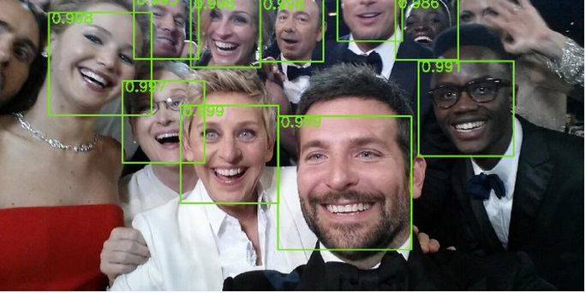
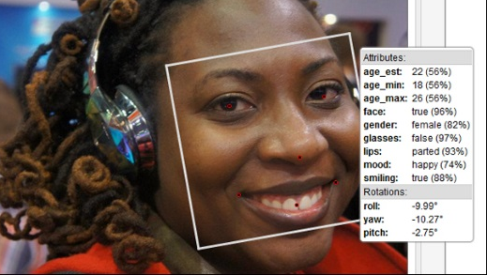
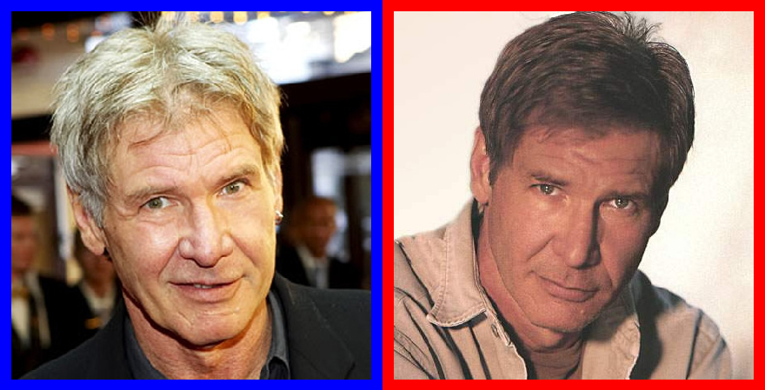
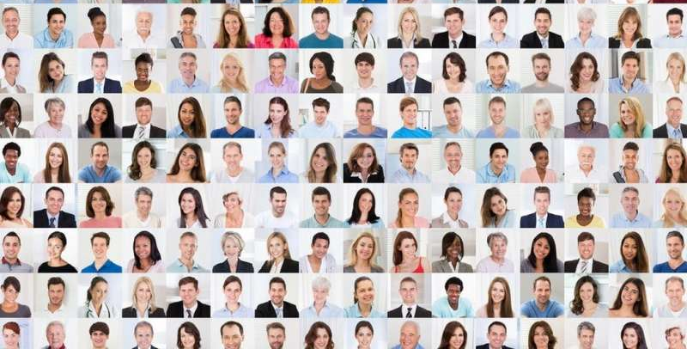
Several Different Vision Tasks Dealing with Faces (these days, the best algorithms for all tasks are based on deep neural networks)
Detection
Attribute Classification
Verification
Recognition

Slide 46
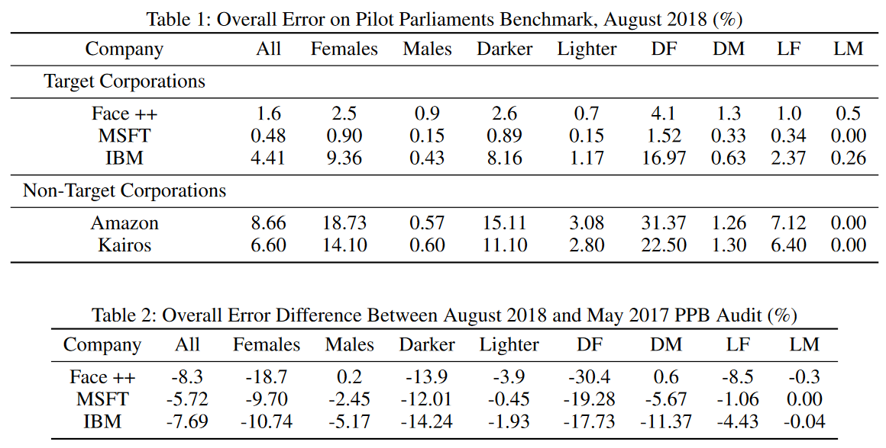
Unequal Performance in Gender Classification Task
I. D. Raji and J. Buolamwini, “Actionable Auditing: Investigating the Impact of Publicly Naming Biased Performance Results of Commercial AI Products,” Proc. AAAI/ACM Conf. Artif. Intell. Ethics Society, Jan. 2019.

Slide 47
But Why?
Skin type?

Slide 48
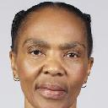

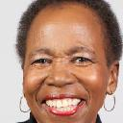







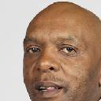
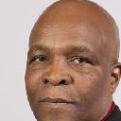




IBM Watson Face Classification API (August 2018)
Test dataset: approximation to Pilot Parliaments Benchmark dataset (Buolamwini & Gebru, 2018)
Dark females
Error rate 17.5%
Light females
Error rate 1.5%
Male
Female
Male
Female
Female
Female
Female
Male
Dark males
Error rate 0.7%
Light males
Error rate 0.5%
Male
Male
Male
Male
Male
Male
Male
Male

Slide 49
Color Theory-Based Experiments
If unequal performance is because of skin tone, then we should be able to get rid of the inequality by making the neural network invariant to skin tone using color theory

Slide 50



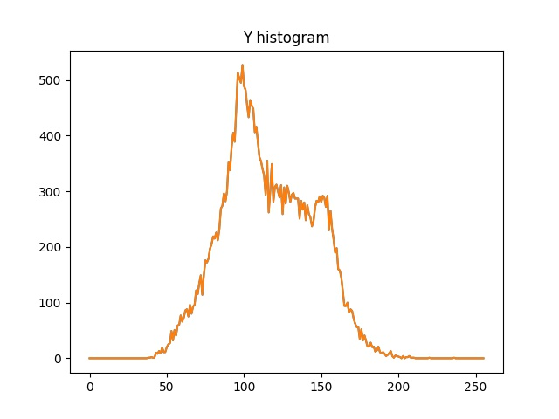
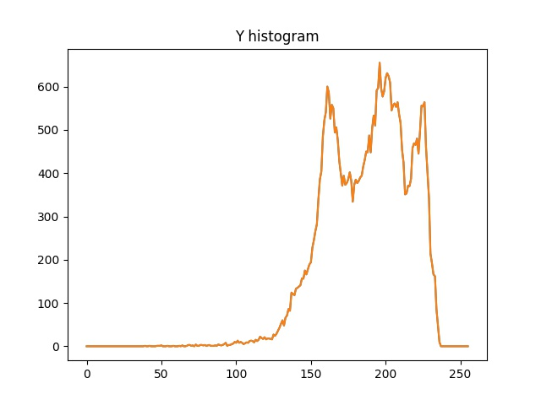
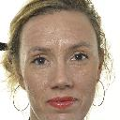
Invariance by Luminance Mode Shift or Optimal Transport
imgCb
imgCb
imgCr
imgCr
set mode of luminance values in image to a desired value
(modeY = 150)
(modeY = 135)
or
imgCb
optimal transport of luminance histogram to a histogram of desired skin type
imgCb
imgCr
imgCr

Slide 51
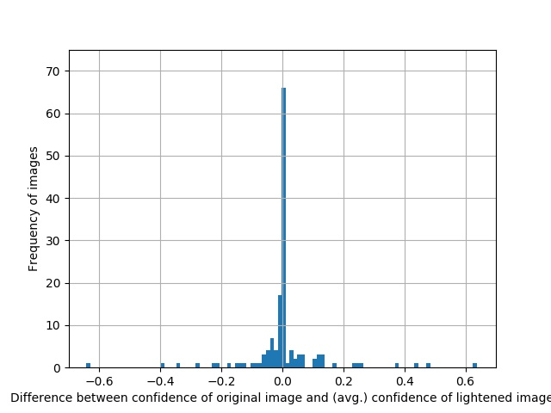
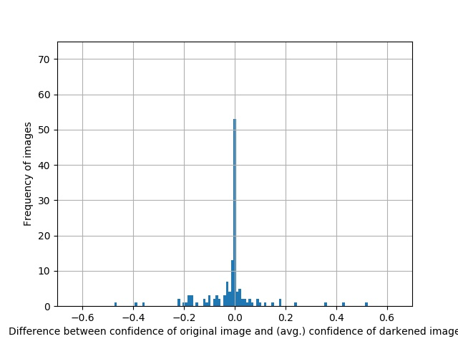
Stability of Classifier Confidence Score with Respect to Lightening and Darkening
No significant effect of darkening or lightening on performance
Skin type is not the reason
No sizable difference between the effect of darkening OR lightening on performance!

Slide 52




New Hypothesis: Hair Length
29 of 33 misclassified dark-skinned females have short hair
Dark-skinned short-haired females: 25% error rate
Dark-skinned long-haired females: 8% error rate
Light-skinned short-haired females: 10% error rate
Light-skinned long-haired females: 0.5% error rate

Slide 53
Face Images Cropped Tight to the Face to Exclude All Hair
Look at classifier with face images tightly cropped to exclude all hair
Continue to have unequal classifier performance across groups
Hair length is not the reason

Slide 54
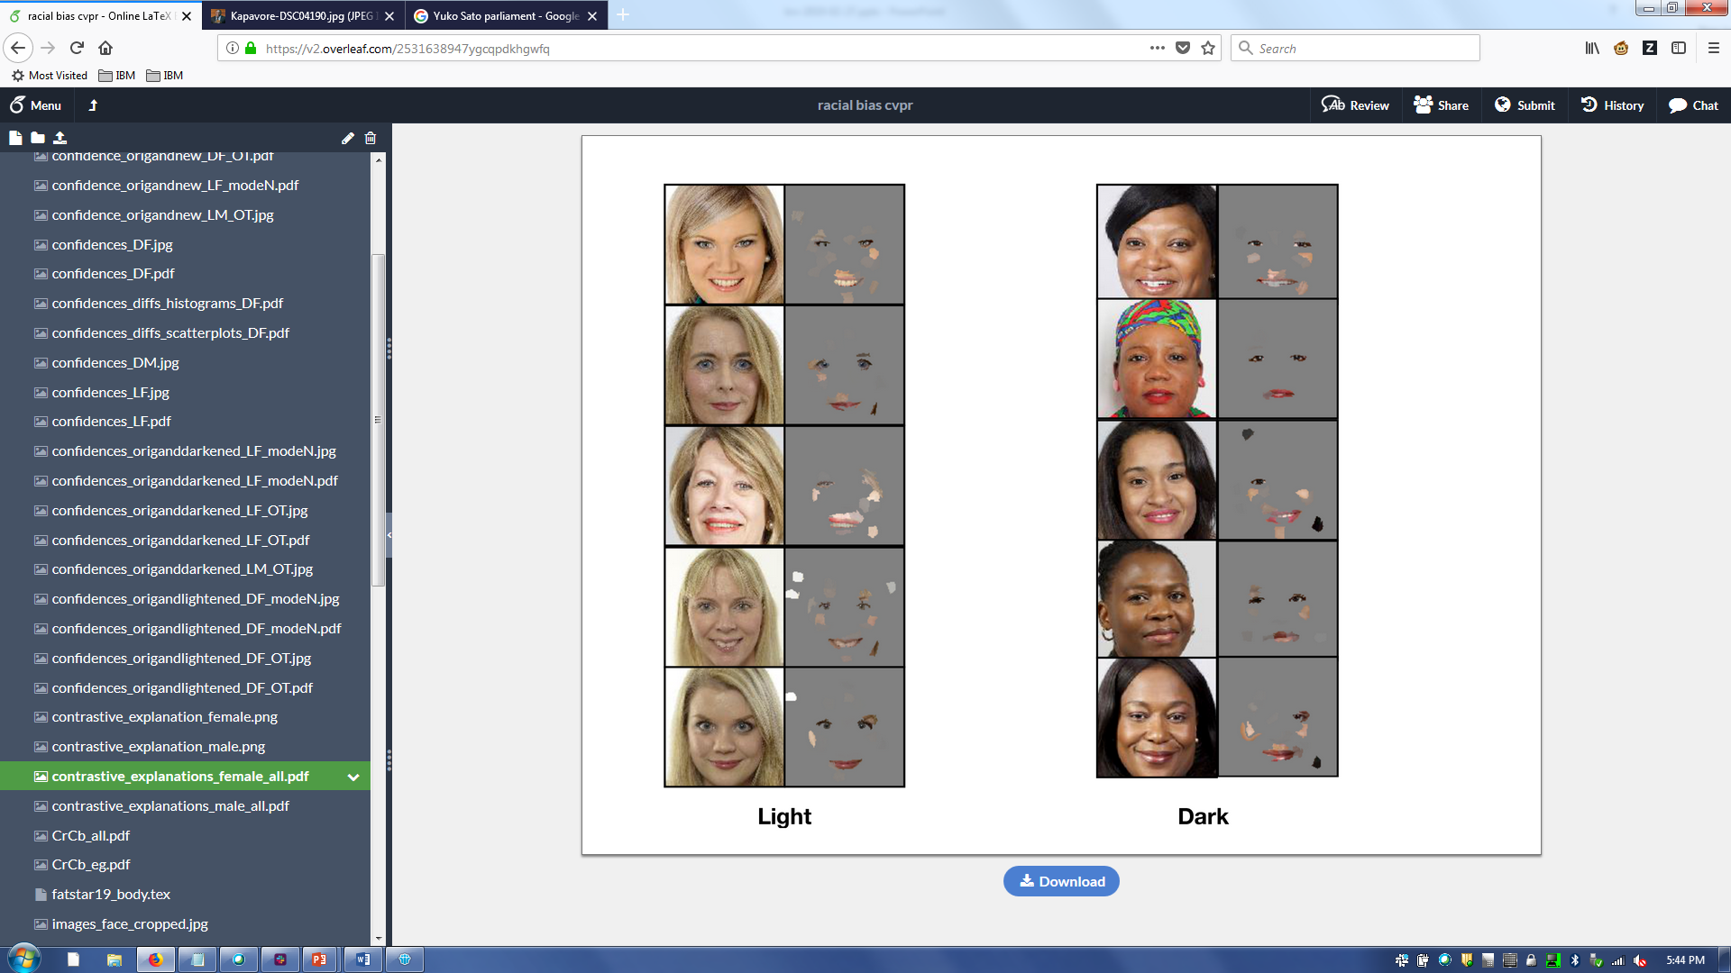
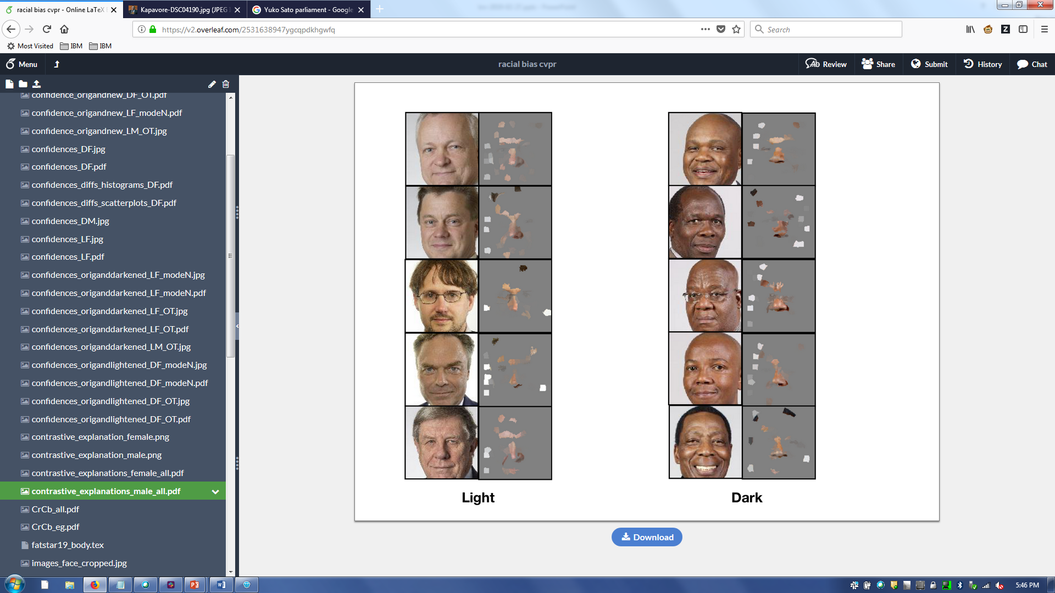
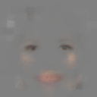
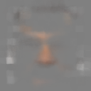
Contrastive Explanations Method (Dhurandhar et al., 2018)
average female
average male

Slide 55
Summary
It isn’t the skin type by itself
(Dark-skinned male accuracy on par with light-skinned male accuracy)
It isn’t the hair length by itself
It is facial features like red/pink lips, cheeks, and eye makeup
Stereotypes of celebrities
Diversity in faces

Slide 56
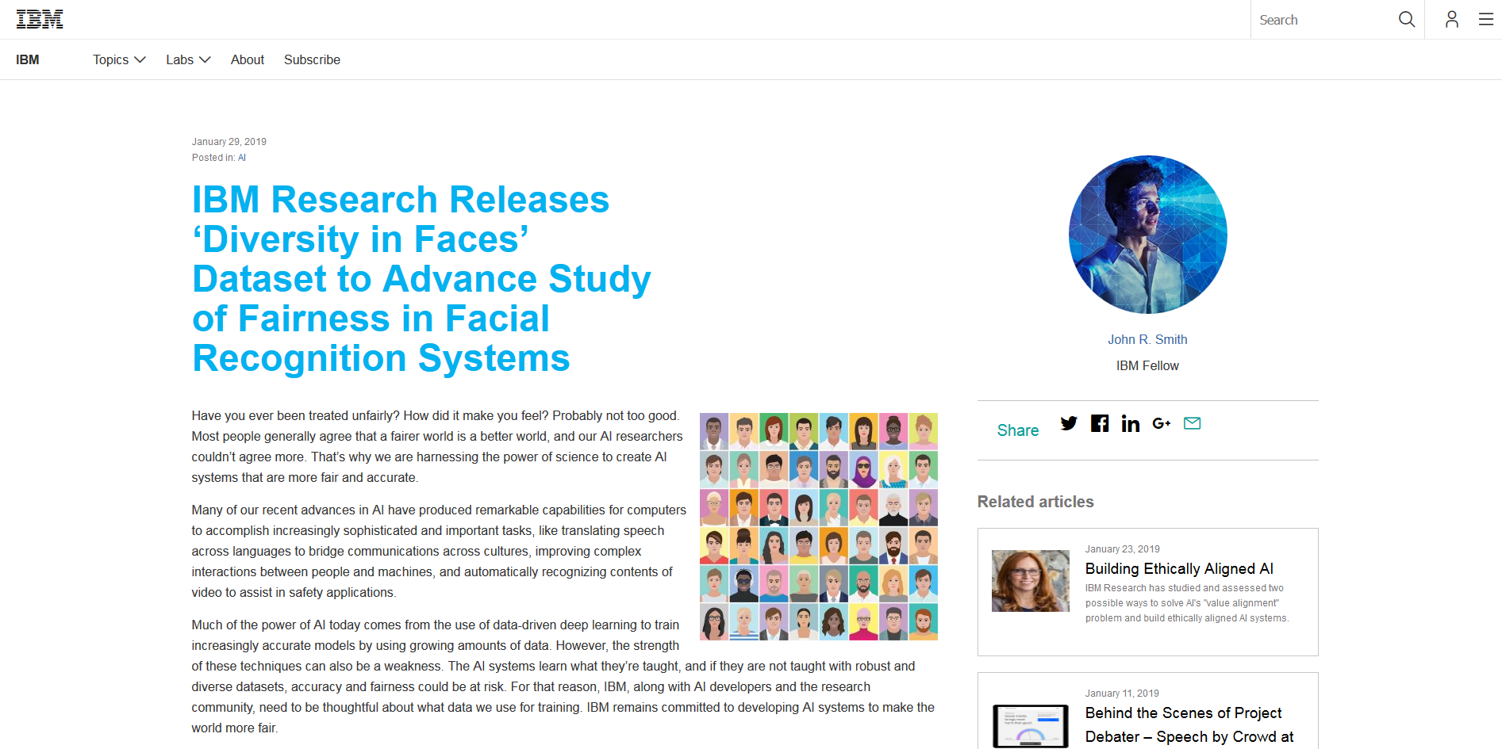
Towards a Solution

Slide 57
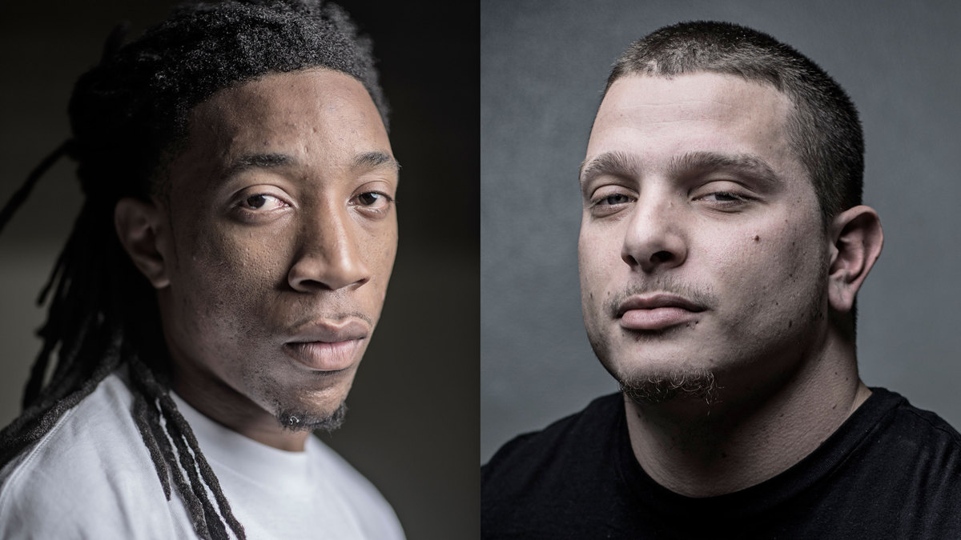
F. P. Calmon, D. Wei, B. Vinzamuri, K. N. Ramamurthy, and K. R. Varshney, “Optimized Data Pre-Processing for Discrimination Prevention,” Advances in Neural Information Processing Systems, Dec. 2017.

Slide 58
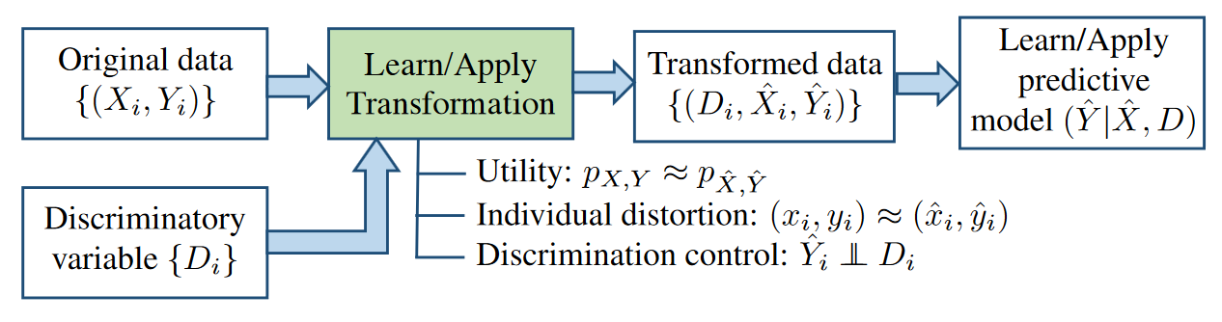

Slide 59

Our Approach
Race | Age | Degree | Priors | Recid
Black | >45 | Misd. | 0 | N
White | 25-45 | Felony | 0 | N
Black | <25 | Felony | 1-3 | Y
White | >45 | Misd. | 0 | N
Given dataset containing
$D$ – discriminatory (protected) variables
$X$ – other (non-protected) variables
$Y$ – outcome
Learn optimized (randomized) mapping
$D, X, Y \underset{⇒}{p_{ \hat{X},\hat{Y}|D,X,Y}} D, \hat{X}, \hat{Y}$
Map both train and test data before model
Race | Age | Degree | Priors | Recid
Black | >45 | Felony | 0 | N
White | >45 | Felony | 0 | N
Black | <25 | Felony | 1-3 | N
White | >45 | Misd. | 0 | N

Slide 60








Optimization Criteria
1. Group discrimination
Control dependence $p_{\hat{Y}|D}$of transformed outcome $\hat{Y}$ on $D$
2. Individual distortion
Avoid large changes in individual features
3. Utility preservation
Retain joint distribution $p_{X,Y}$ so model can still learn task
$$\min{ Δ(p_{\hat{X},\hat{Y}}, p_{X,Y})}$$
$$s.t. J\left(p_{\hat{Y}|D}\left(\hat{y} | d_{1}\right),p_{\hat{Y}|D}\left(\hat{y} | d_{1}\right)\right)≤ε$$
$$E\left[δ\left(\left(x,y\right), \left(\hat{X},\hat{Y}\right)\right)| d,x,y\right]≤c$$
$$x,y$$
$$δ$$
$$\hat{x},\hat{y}$$
$$d_{1}$$
$$d_{2}$$
Notes:
#2 motivated by individual fairness, want to respect an individual’s feature values as much as possible especially in testing
#1, #2 conflict

Slide 61

Original COMPAS Dataset
re-commit crime
red = misdemeanor blue = felony
race

Slide 62

Pre-Processed COMPAS Dataset
re-commit crime
red = misdemeanor blue = felony
race

Slide 63
Interpretable Classifier Learned from Original Dataset
prior crimes
> 0
= 0
race
predicted not to re-offend
African-American
Caucasian
prior crimes
age
> 3
≤ 3
< 45
≥ 45
predicted to re-offend
predicted not to re-offend
predicted to re-offend
predicted not to re-offend

Slide 64
Interpretable Classifier Learned from Pre-Processed Dataset
prior crimes
> 3
≤ 3
predicted to re-offend
predicted not to re-offend

Slide 65
Balanced Accuracy vs. Fairness
abs(1-disparate impact) must be close to zero (typically < 0.2) for classifier predictions to be fair.
For a classifier trained with original training data, at the best classification rate, this measure is quite high. This implies unfairness.
For a classifier trained with transformed training data, at the best classification rate, the measure drops significantly, implying bias mitigation.

Slide 66

P. Sattigeri, S. C. Hoffman, V. Chenthamarakshan, and K. R. Varshney, “Fairness GAN,” IBM Journal of Research and Development, forthcoming.

Slide 67

Our Approach
An auxiliary classifier generative adversarial network (AC-GAN) with one main twist: try to predict the protected attribute as poorly as possible from the features

Slide 68









Fairness GAN
1. Joint Conditional Generative Model
Learn a generative model $p_{g}(x,y|d)$ that matches the true distribution $p_{data}\left(x,y \right|d)$.
Label and Sensitive Attribute Independence Maximization
Make outcome and sensitive variable ($y and d$) independent in the learned distribution.
3. GAN Formulation
Posed as an adversarial learning problem and solved using novel GAN formulation
Discriminator Training:
$$\min{ L_{D}= L_{S}+L_{F}}$$
Generator Training:
$$\max{ L_{G}= L_{S}−L_{F}}$$
$$where$$
$$L_{S}:source \left(real or fake\right)$$
$identification loss$
$$L_{F}:fairness loss$$
$z, d$
$$Fair$$
$$Generator:$$
$$p_{θ}(x,y|d)$$
$$Generated$$
$$Data :$$
$p_{g}(x,y|d)$
$$Real$$
$Data :p_{data}\left(x,y \right|d)$
$$GAN Discriminator Matching loss$$
$$+ Fairness loss$$

Slide 69

Fairness GAN

Slide 70


Fairness GAN

Slide 71

R. E. K. Bellamy et al., “AI Fairness 360: An Extensible Toolkit for Detecting, Understanding, and Mitigating Unwanted Algorithmic Bias,” IBM Journal of Research and Development, forthcoming.

Slide 72
Fairness Measures | Framework to test given algorithm on variety of datasets and fairness metrics | https://github.com/megantosh/fairness_measures_code
Fairness Comparison | Extensible test-bed to facilitate direct comparisons of algorithms with respect to fairness measures. Includes raw & preprocessed datasets | https://github.com/algofairness/fairness-comparison
Themis-ML | Python library built on scikit-learn that implements fairness-aware machine learning algorithms | https://github.com/cosmicBboy/themis-ml
FairML | Looks at significance of model inputs to quantify prediction dependence on inputs | https://github.com/adebayoj/fairml
Aequitas | Web audit tool as well as python lib. Generates bias report for given model and dataset | https://github.com/dssg/aequitas
Fairtest | Tests for associations between algorithm outputs and protected populations | https://github.com/columbia/fairtest
Themis | Takes a black-box decision-making procedure and designs test cases automatically to explore where the procedure might be exhibiting group-based or causal discrimination | https://github.com/LASER-UMASS/Themis
Audit-AI | Python library built on top of scikit-learn with various statistical tests for classification and regression tasks | https://github.com/pymetrics/audit-ai

Slide 73
AI Fairness 360
Differentiation
Datasets
Toolbox
Fairness metrics (30+)
Fairness metric explanations
Bias mitigation algorithms (9+)
Guidance
Industry-specific tutorials
Comprehensive bias mitigation toolbox (including unique algorithms from IBM Research)
Several metrics and algorithms that have no available implementations elsewhere
Extensible
Designed to translate new research from the lab to industry practitioners (e.g. scikit-learn’s fit/predict paradigm)

Slide 74


Slide 75
Topics
Trustworthy machine learning and artificial intelligence
Epistemic uncertainty and safety
Fairness
Understanding Unequal Performance of Gender Classification from Face Images
Optimized Pre-Processing
Fairness GAN
AI Fairness 360 Toolkit
Conclusion

Slide 76
Conclusion
We’re already getting very high accuracies on many narrow tasks
We need something more for high-stakes applications
Safety, security, i.e. dealing with epistemic uncertainty in addition to risk
Transparency
Broad research agenda
Several pieces of work on fairness (plus more)
Several pieces of work on interpretability and end-to-end transparency
Towards a unified theory of trustworthy machine learning

Slide 77

Standard Conception of Machine Learning

Slide 78

Really a Human-Machine Collaboration
When you create a Human+AI team, the hard part isn’t the ‘AI’. It isn’t even the ‘Human’. It’s the ‘+’. (Case, 2018)

Slide 79
Explainability
The function $γ(X_{1})$ can contain both predicted labels and explanations.

Slide 80

Model Mismatch – Epistemic Uncertainty
$γ(X_{1})$ is trained on a distribution $q_{X_{1},Y}$, but we would have really liked it to have been trained on a distribution $p_{X_{1},Y}.$ Such mismatch captures unfairness, dataset drift, and data poisoning attacks.

Slide 81
http://aif360.mybluemix.net https://github.com/ibm/aif360 https://pypi.org/project/aif360

